Slide 1
Page Object Model (POM)

Slide 2
Learning Objectives
By the end of this lecture, you should be able to:
  Implement the Page Object Model using Page Classes and PageFactory.
  Create reusable page methods and manage WebElements within Page Classes.
  Separate test logic from page-specific logic.
  Use configuration properties and a ConfigReader to manage test configuration.
  Convert an existing Selenium test into a structured POM-based automation project.

Slide 3
POM Overview
Page Object Model (POM): A design pattern that creates an object repository for web elements, separating test logic from UI logic.
How it works: POM treats web pages as classes, with elements as variables and user actions as methods. It uses the By annotation to describe page objects, and each object must be initialized.
Benefits: POM reduces code duplication, improves test maintenance, and supports the reuse of page methods.
Key Components:
  Locators: Define web elements (e.g., buttons, input fields).
  Methods: Define actions (e.g., click, type text).

Slide 4
Pagefactory overview
Page Factory: A class that implements POM and offers a more efficient way to set up Page Objects.
How it works: Page Factory uses the @FindBy annotation to describe page objects, and all elements are initialized with initElements().
Benefits: Page Factory is more optimized than POM, and it efficiently handles exceptions.

Slide 5
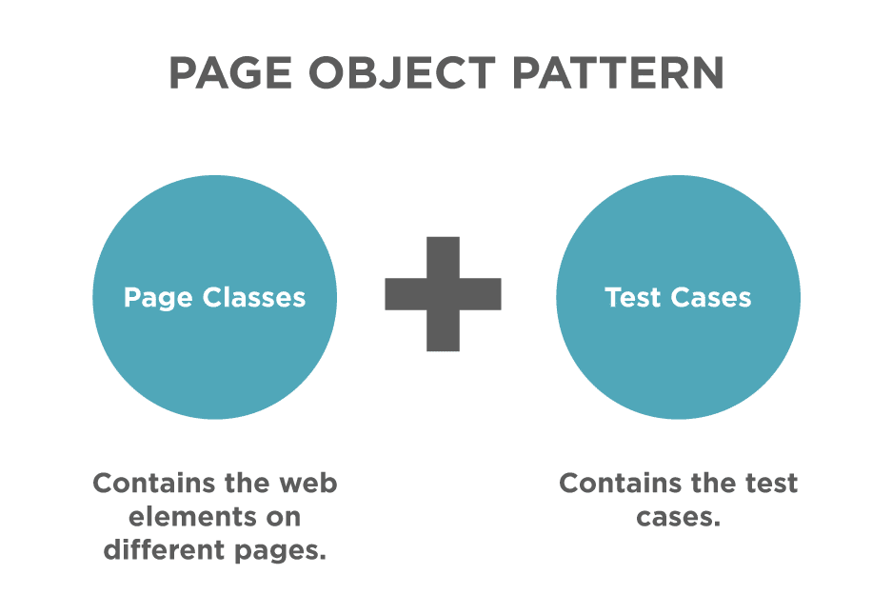
Page object model/pattern

Slide 6
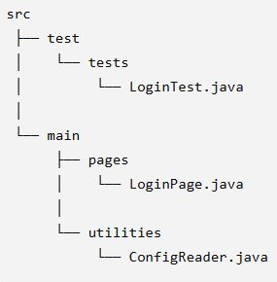
POM Project Structure

Slide 7
Benefits
Benefits:
  If the UI changes, only the page object code needs to be updated, not the tests.
  All UI-related changes are managed in one location, simplifying maintenance.
Example Scenario:
  Old Scenario: Updating 50 test scripts when a button ID changes.
  New Scenario with POM: Update the button locator in one place (page class), and all tests are updated automatically.

Slide 8
Page Factory annotations @FindBy
Unlike the regular approach of initializing web page elements using FindElement or FindElements, the Page Factory uses the @FindBy annotation.
The annotations used in Page Factory are descriptive. Moreover, they help improve code readability, example:
  @FindBy(id="userName") WebElement username;

Slide 9
@FindBys
To locate a web element with more than one search criteria, you can use @FindBys annotation (works if BOTH criteria's meet). Example:
Consider the HTML code below:
<div class = "custom-control-check-box">
<input type="checkbox" id="game-chk-box" class="custom-control-input" value="1"/>
</div>
@FindBys({
@FindBy(class="custom-control-check-box"),
@FindBy(id="game-chk-box")
})
WebElement chkBox;

Slide 10
@FindAll
The @FindAll annotation locates the web element using more than one criteria, given that at least one criteria match. Contrary to @FindBys, it uses an OR conditional relationship between the multiple @FindBy.
Consider the HTML code below:
<button id = "submit" type = "submit" name= "sbmtBtn" class =" btn btn-primary">Submit</button>
The element can be located using @FindAll annotation as below:
@FindAll({
@FindBy(id="btn", //doesn't match
@FindBy(name="sbmtBtn"), //Matches
@FindBy(class="btn-primary") //doesn't match
}) WebElement submitButton;
The above annotation would locate the submit button even though only one criterion matches @FindAll works on one or more criteria.

Slide 11
initElements()
Initializing the elements using initElements()
  This is a static method used to initialize the web elements that we locate using the @FindBy or other annotation(s), thereby instantiating the page class.
  PageFactory.initElements(WebDriver driver, java.lang.Class.pageObjectClass);

Slide 12
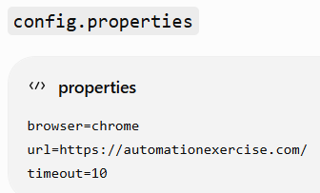
Configuration Properties & ConfigReader
Configuration values should be separated from test code.
Using a config.properties file and a ConfigReader class in your Selenium project centralizes configuration settings such as URLs, browser type, and timeouts.

Slide 13
Page Object Model (POM) using PageFactory and ConfigReader
For detailed project help, refer to this MS WORD document “Page Object Model (POM) using PageFactory and ConfigReader.doc”

Slide 14
Reference
https://toolsqa.com/selenium-webdriver/page-factory-in-selenium/

